Slide 1
Python

Slide 2
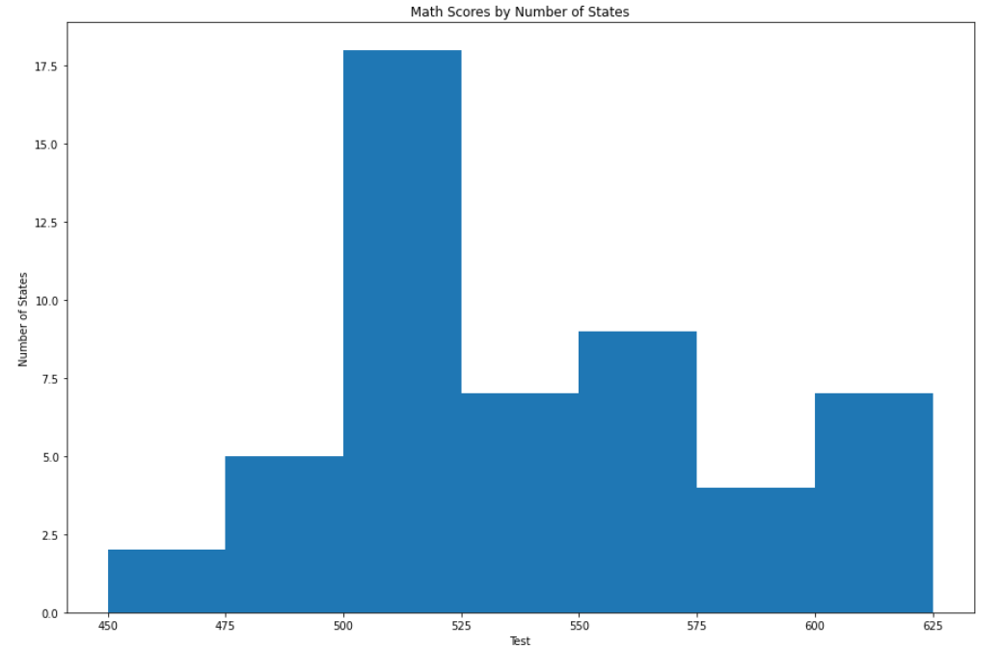
Python – Histogram

Slide 3
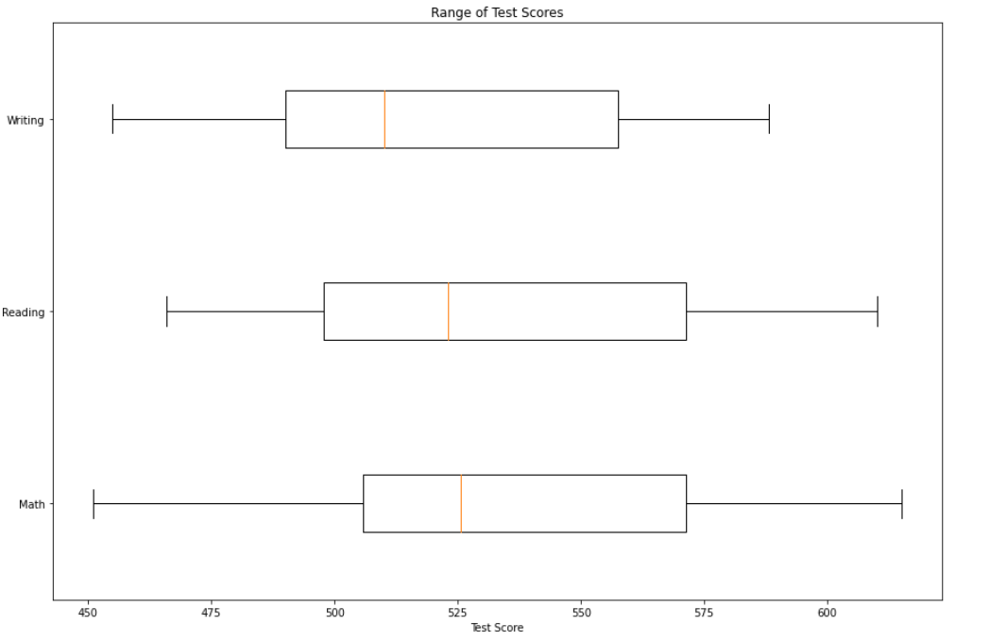
Python – Box Plot

Slide 4
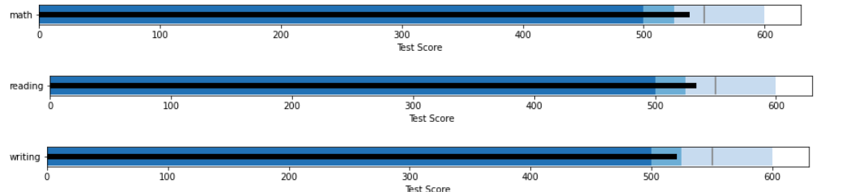
Python – Bullet Chart

Slide 5
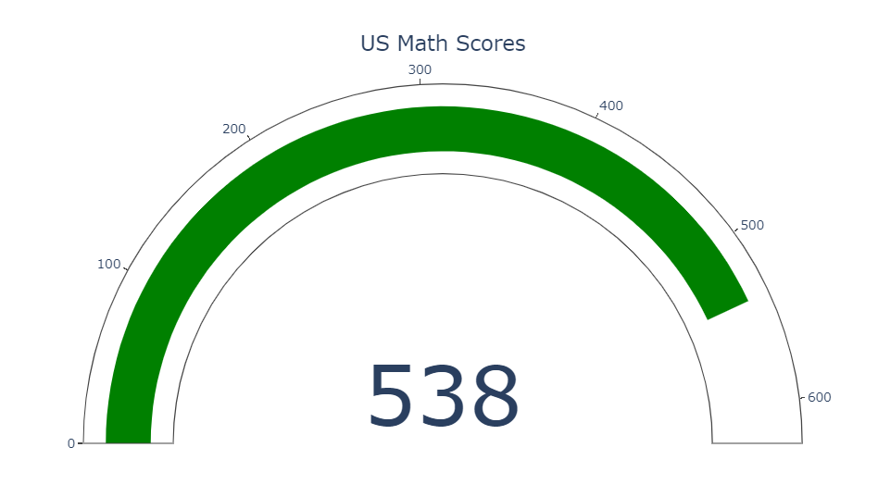
Python – KPI Gauge

Slide 6
Power BI

Slide 7
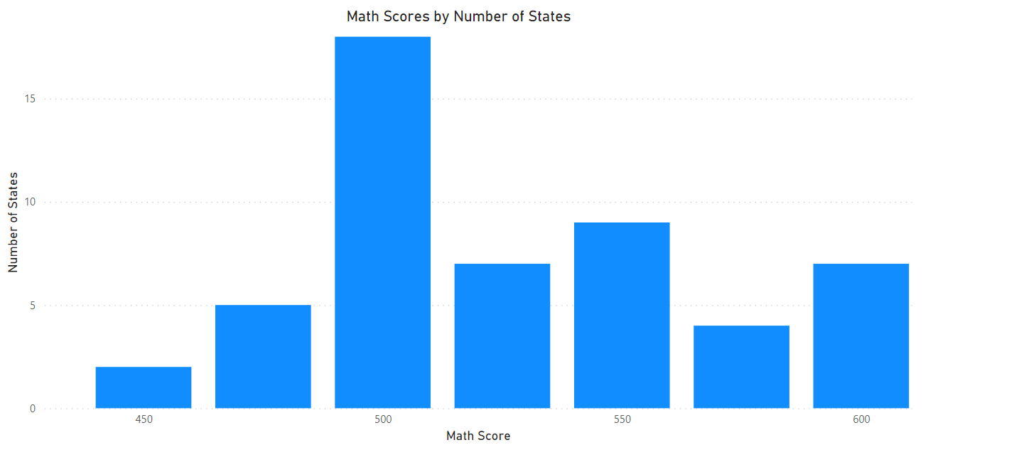
Power BI – Histogram

Slide 8
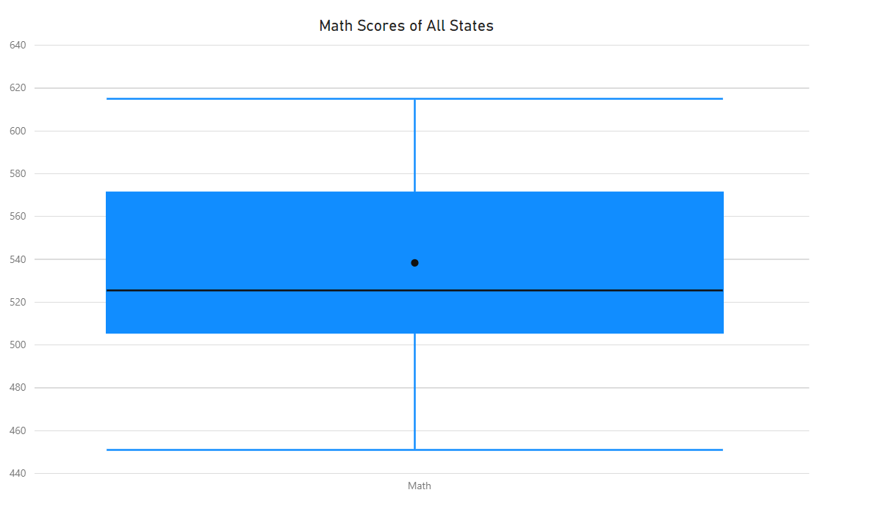
Power BI – Box Plot

Slide 9
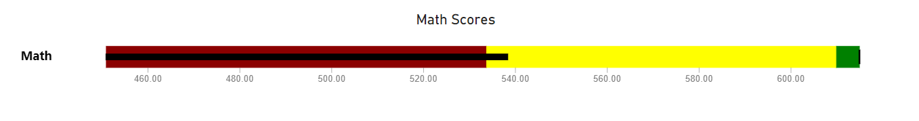
Power BI – Bullet Chart

Slide 10
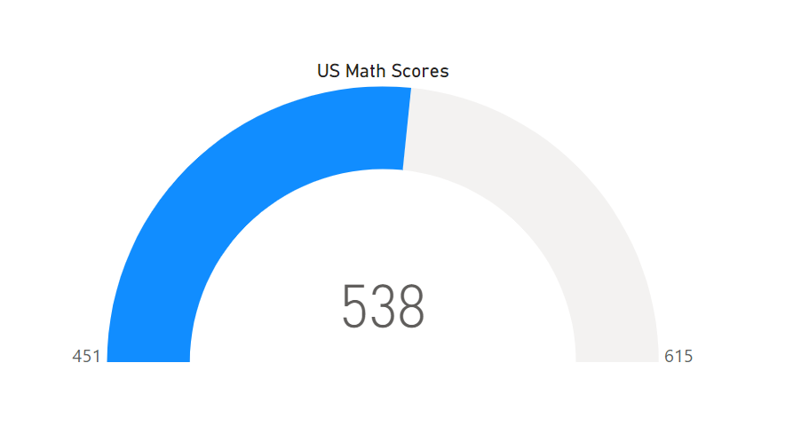
Power BI – KPI Gauge

Slide 11
R

Slide 12
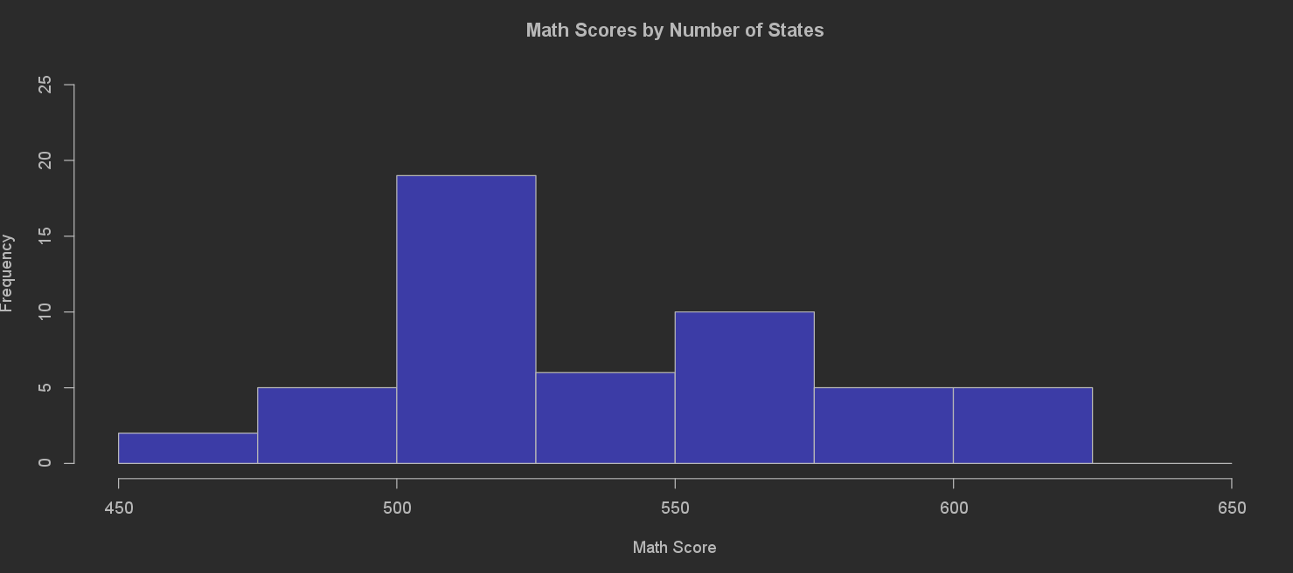
R – Histogram

Slide 13
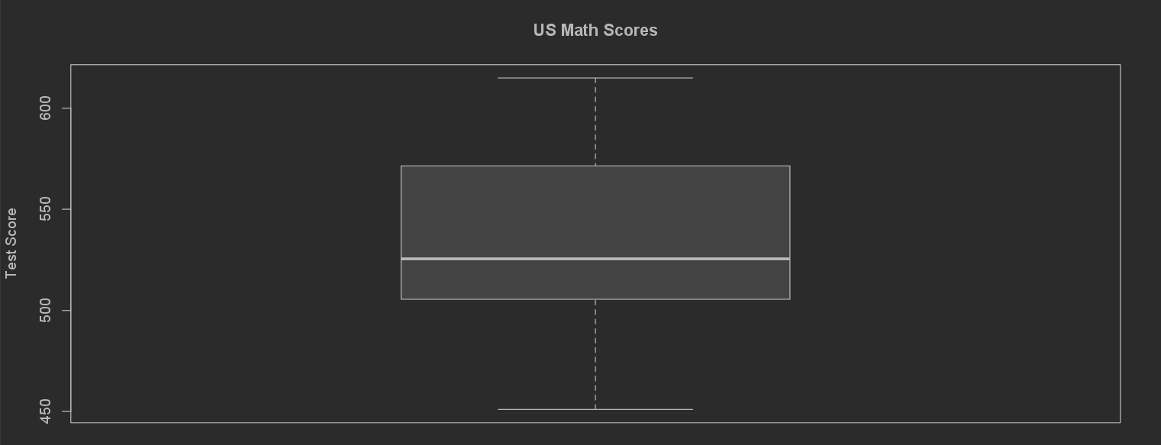
R – Box Plot

Slide 14
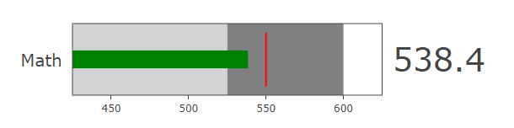
R – Bullet Chart

Slide 15
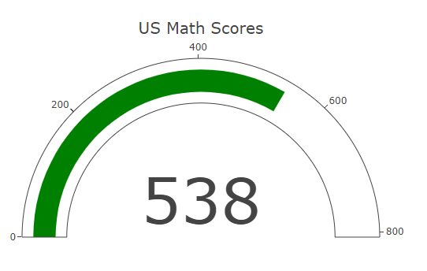
R – KPI Gauge

